Slide 1
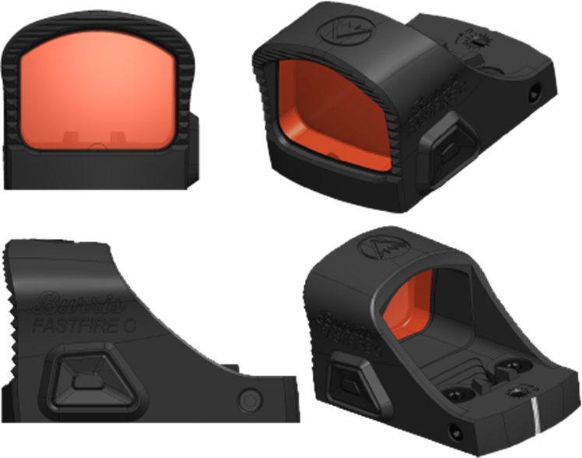
FastFire C
FastFire Family Line Extension:
Focused on Compact/Sub-Compact Cary Pistols
Utilizes Shield RMSc Footprint
Features:
Ultra-Light Reinforced Polymer Frame
Aspherical Glass Lens
25,000 hours Battery life (Medium)
6 MOA dot with Burris Intelligent Auto Brightness
Unique: Includes Removable Rear Sight
Competes With:
Shield Mini
SIG Romeo Zero Elite
Vortex Defender CCW
Holosun 407k
Early to Mid-January 2024 Launch
MSRP: $299
Item #: 300239

Slide 2
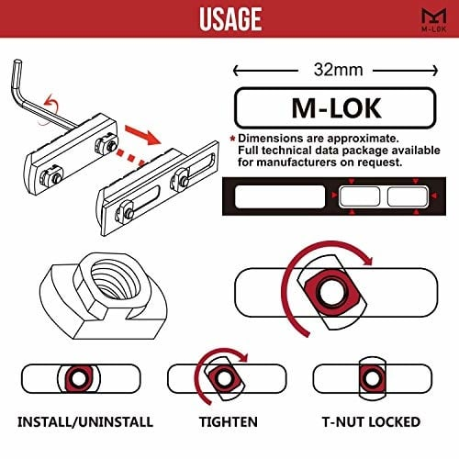
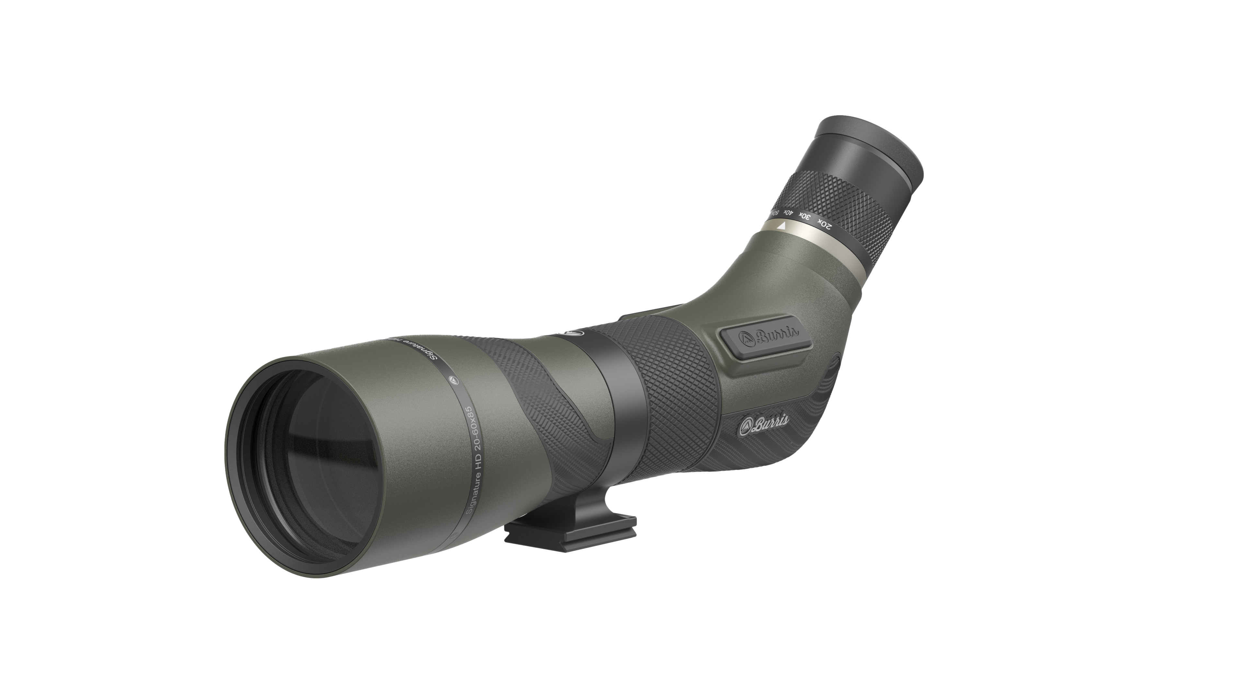
Signature HD Spotting Scope
Features:
Refreshed Industrial Design
Central Focus Wheel
Built off existing optical system with improved coatings
M-LOK Accessory Mounts
FastFire Integration
Picatinny
Universal Red Dot Plate
Integrated ARCA Mount
Compatible with current MOA/MIL eyepieces
Mid to Late January 2024
MSRP $2099
Item # 300103

Slide 3
XTR PRO Black
Item Number:
5.5-30x56mm
3 models
Reticles:
SCR2
SCR ¼ MIL
Horus TREMOR5
MSRP: $2,640 - $3,000
Item #: 20222, 20223, 20224
Available in black Q4 2023 with the addition of an exposed windage knob.

Slide 4
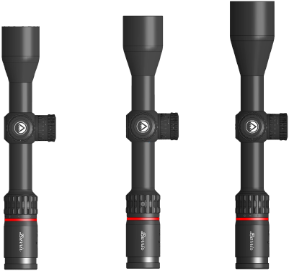
3 New Models 2024
4-20x50 mm
Current Model
2.5-12x42mm
# 200201
3-15x44mm
# 200202
4-20x50 mm
# 200203

Slide 5
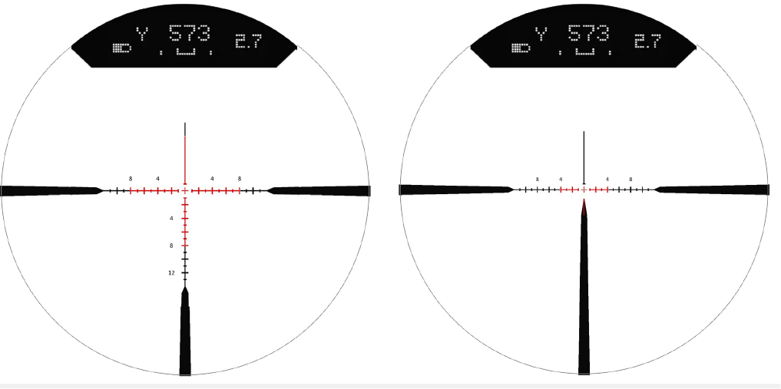
3 New Veracity PH Models 2024
RC-MOA “Rapid Cross MOA” Available on 3-15x and 4-20x
3PW-MOA “3P Wind MOA” Exclusive to 2.5-12x

Slide 6
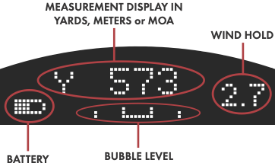
3 New Veracity PH Models 2024
3 New Veracity PH Models 2024
Revolutionary PĒK system combines a Heads-up-Display (HUD) and a Click-less Digital Elevation Turret to provide a seamless custom ballistic drop solution.
Now with New Illuminated Reticles
Shorter and Lighter
Improved Optical System ED Glass
3 new Magnifications
4-20x50: January 2024
3-15x44: January 2024
2.5-12x42: March 2024
Revolutionary PĒK system combines a Heads-up-Display (HUD) and a Click-less Digital Elevation Turret to provide a seamless custom ballistic drop solution.
Now with New Illuminated Reticles
Shorter and Lighter
Improved Optical System ED Glass
3 new Magnifications
2-12x 42mm
3-15x44mm
4-20x50mm
MSRP. $1399-$1599
SRP. $1399-$1599

Slide 7
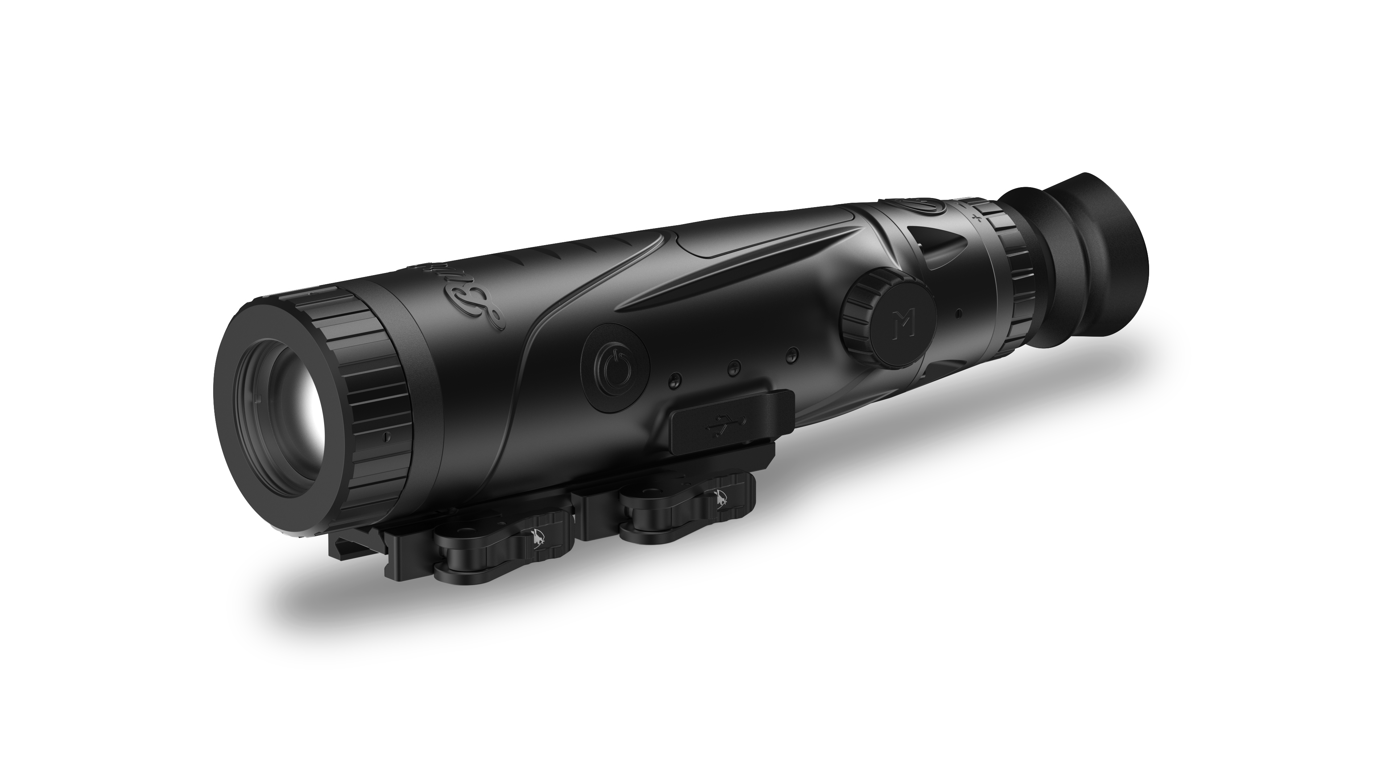
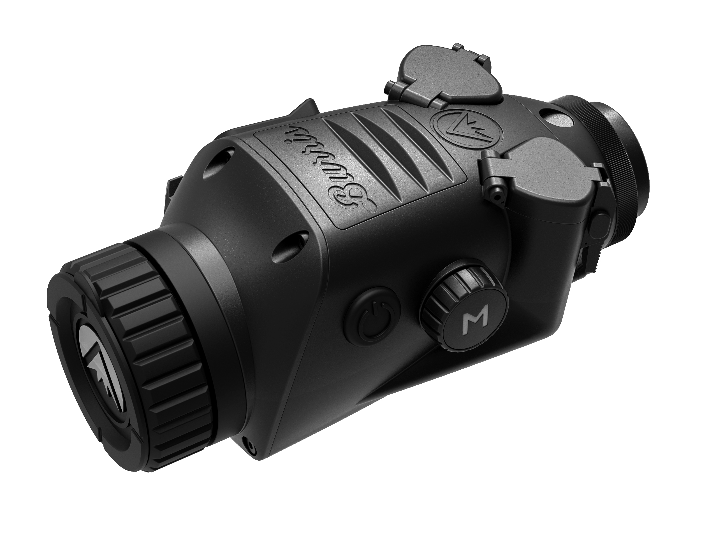
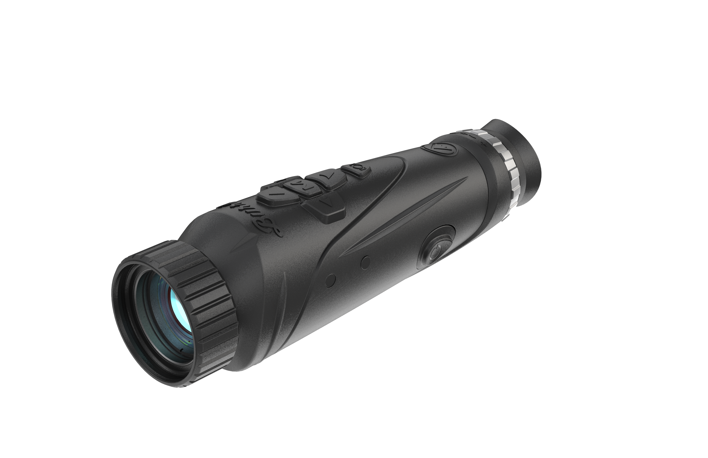
Burris V3
Simple. Fast. Powerful.
6 New Products
Adding 640x480
Extended Battery Life
4 New Color Pallets
Signature Outline
One Shot Zero
More Details to Follow
Q1 2024 Launch
BTS v3 640: 300605
BTS v3: 300603
BTC v3: 300623
BTH v3: 300636
RT6 Combo
RT3 Combo

Slide 8
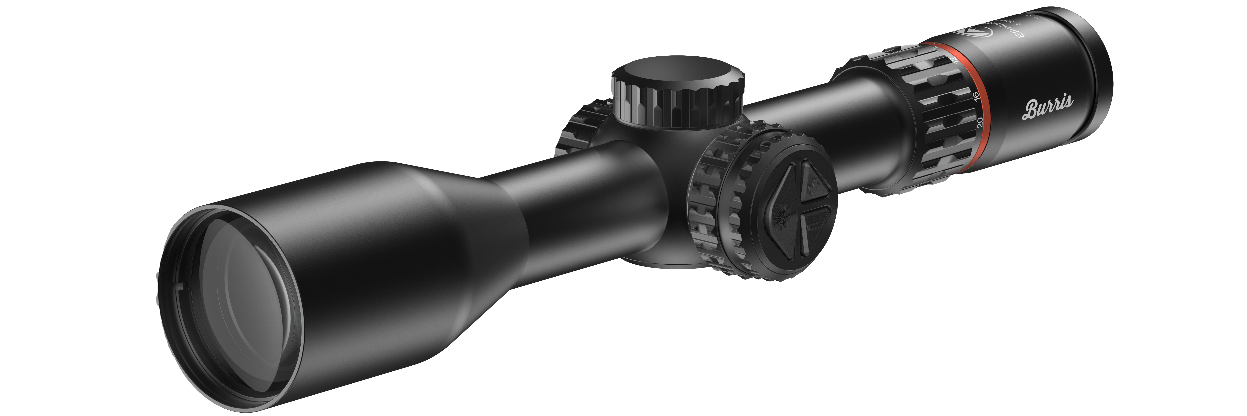
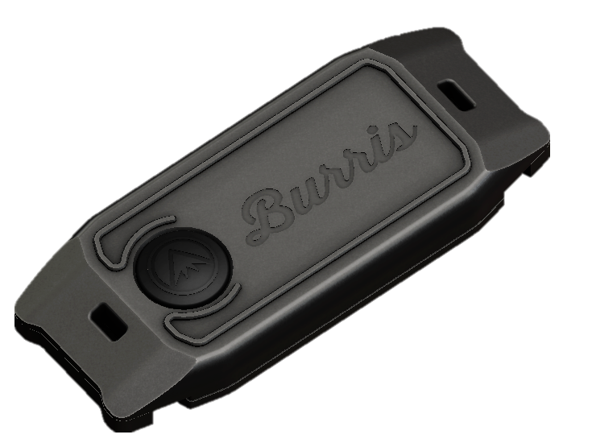
Eliminator 6 Train Far. Hunt Responsibly. Don’t Miss

Slide 9
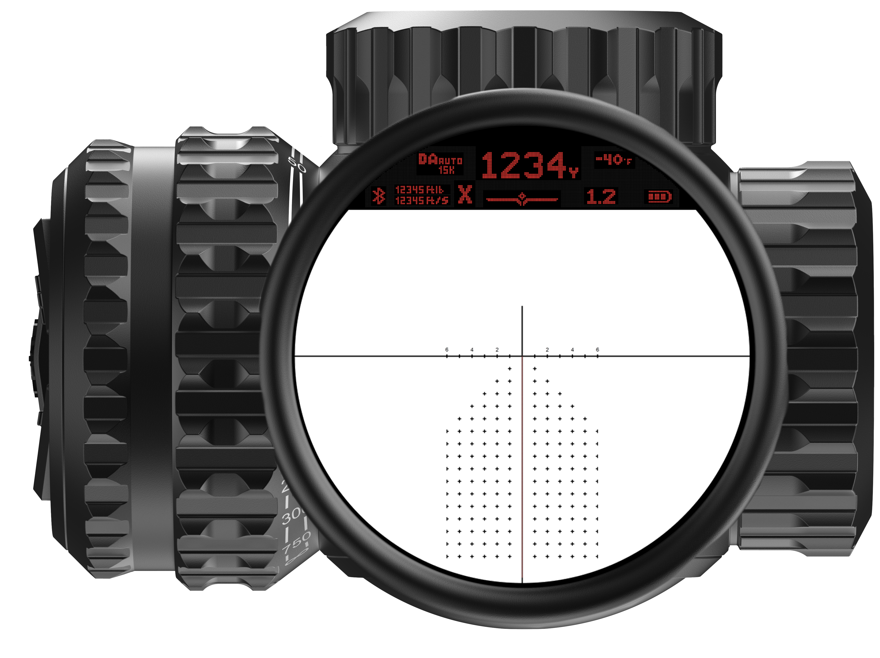
Eliminator 6
Bluetooth (BurrisConnect)
Built-in Thermometer, Barometer
Traditional power ring with position sensor for magnification compensation
New 5x optical system with 4-20x magnification
Traditional Diopter adjust with +2.0 dpt to -3.0 dpt
Side Focus Adjust from 25yards to Infinity
Bullet Velocity at ranged distance
Bullet Energy at ranged distance
Shot Energy Indicator (X)
2,000+ Yard Ranging
All in one, rangefinder, inclinometer, internal DOPE card and precision riflescope
MSRP: $2899.00
Item #: 200177
Mid to Late January 2024
Launch

