Slide 1
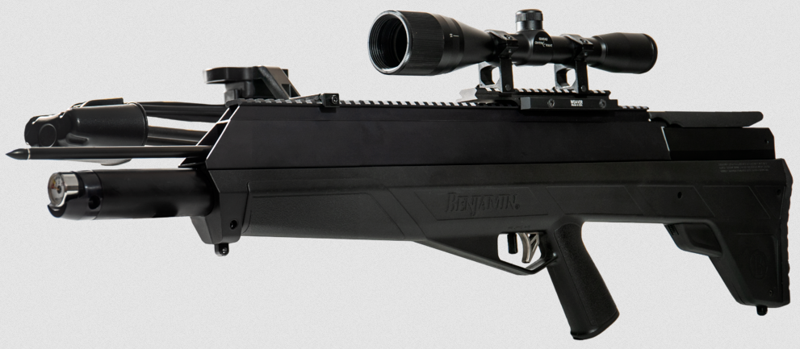
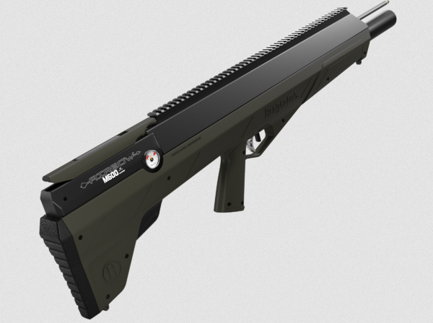

AIRBOW 450
Kit BPABX
BPAB/BPABX
MODEL NUMBER
PCP
POWERPLANT
(B)Cost $420/Retail $599 (X)Cost $490/Retail $699
MAP RETAIL
In Market
AVAILABLE
Gauge repositioned on the breech
Gun Only BPAB
3600PSI
Bull Pup Design 33” overall
Up to 450 FPS with 26” 375gr Arrow
Up to 168 FPE
Designed and built for hunting large game
KIT Includes 3 Arrows, quiver, 20MOA Rail, 6X40 mm Scope, Sling
Standard male foster fitting

Slide 2
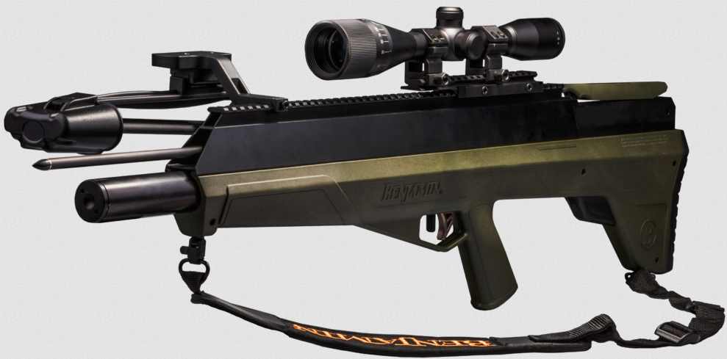
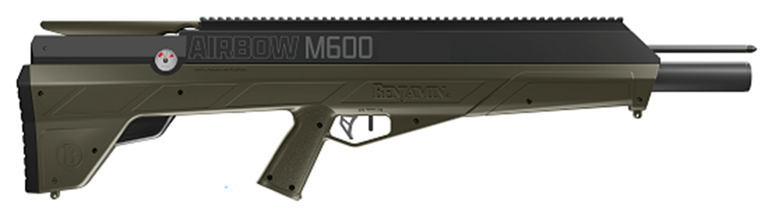
AIRBOW M600
Kit BPABMX
BPABM/BPABMX
MODEL NUMBER
PCP
POWERPLANT
(M)Cost $600/MAP $800 (MX)Cost $770/MAP $1099
MAP RETAIL
April 2024
AVAILABLE
Gauge repositioned on the breech
Gun Only BPABM
• MAGNUM SERIES
• Up to 600FPS with 26” 375gr Arrow
• Up to 300 FPE
• Designed and built for hunting large game
• KIT Includes 3 Arrows, quiver, 20MOA Rail, 6x40mm Scope, Sling
3600PSI
Standard male foster fitting

